Slide 1
Performance Measures in Biometric Systems

Slide 2
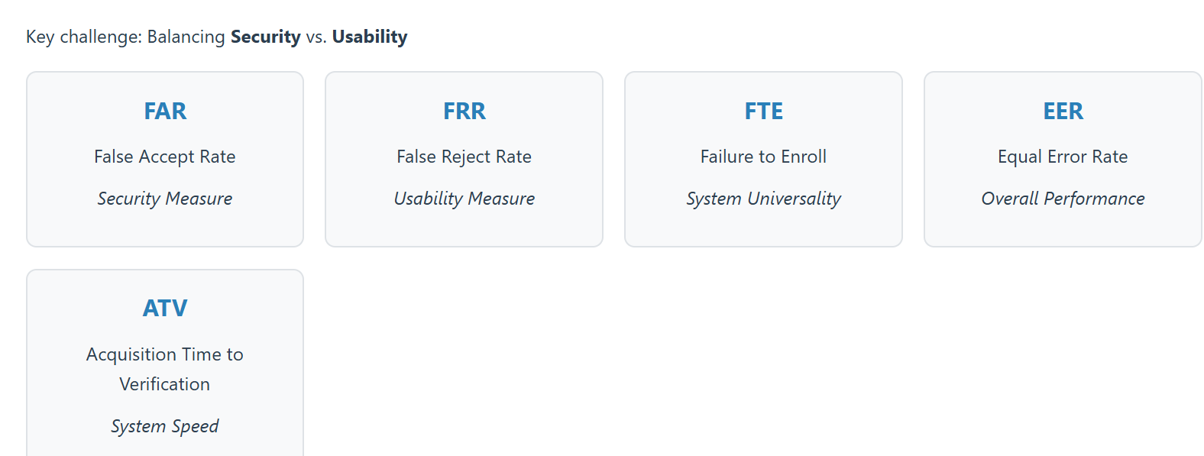
Performance Measures Overview
Notes:
Biometric systems are evaluated using a standard set of performance metrics. The central tension across all of them is balancing security against usability — tightening one typically loosens the other.
FAR — False Accept Rate Security measure. The rate at which the system incorrectly accepts an unauthorized user as legitimate. A high FAR means impostors are getting through — this is the critical metric for security-sensitive applications.
FRR — False Reject Rate Usability measure. The rate at which the system incorrectly rejects a legitimate, authorized user. A high FRR frustrates real users and drives poor adoption, even if the system is technically secure.
FTE — Failure to Enroll System universality. The rate at which individuals cannot be enrolled in the system at all — due to factors like worn fingerprints, certain disabilities, or sensor limitations. This measures how well the system accommodates the full population it's meant to serve.
EER — Equal Error Rate Overall performance. The point at which FAR and FRR are equal — the threshold where false accepts and false rejects occur at the same rate. A lower EER indicates a more accurate system overall, and it's commonly used to compare different biometric systems on a single number.
ATV — Acquisition Time to Verification System speed. The time required to capture the biometric sample and complete verification. This affects throughput and user experience, particularly in high-volume settings like airports or turnstiles.
Closing line FAR and FRR are directly linked by an adjustable threshold — lowering it improves usability but weakens security, and vice versa. EER gives us a single reference point for that tradeoff, while FTE and ATV round out the picture with universality and speed.

Slide 3
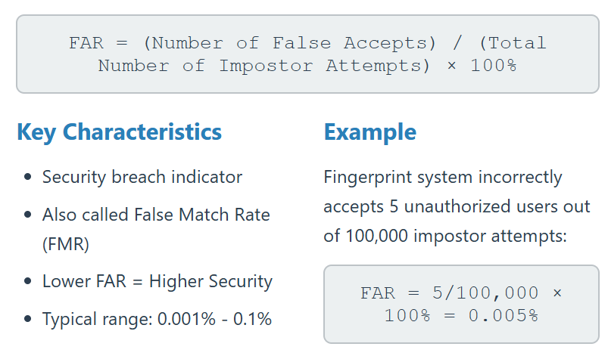
False Accept Rate (FAR)
Definition
Probability that the system incorrectly accepts an unauthorized user
Notes:
FAR — False Accept Rate Security measure. The rate at which the system incorrectly accepts an unauthorized user as legitimate. A high FAR means impostors are getting through — this is the critical metric for security-sensitive applications.
Security measure. The rate at which the system incorrectly accepts an unauthorized user as legitimate. A high FAR means impostors are getting through — this is the critical metric for security-sensitive applications.

Slide 4
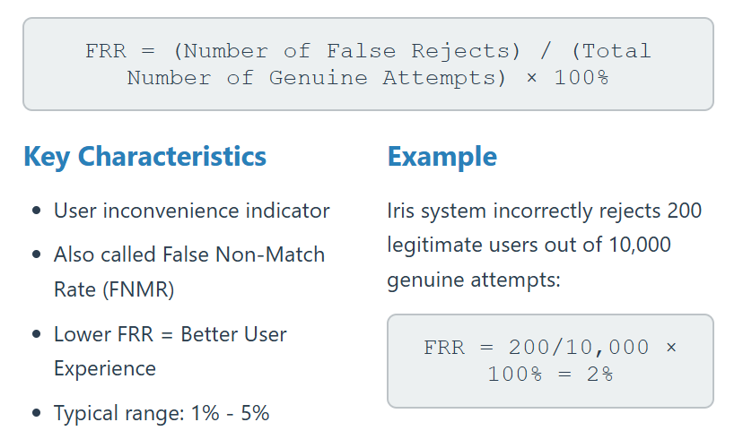
False Reject Rate (FRR)
Definition
Probability that the system incorrectly rejects an authorized user
Notes:
FRR — False Reject Rate Usability measure. The rate at which the system incorrectly rejects a legitimate, authorized user. A high FRR frustrates real users and drives poor adoption, even if the system is technically secure.
Usability measure. The rate at which the system incorrectly rejects a legitimate, authorized user. A high FRR frustrates real users and drives poor adoption, even if the system is technically secure.

Slide 5
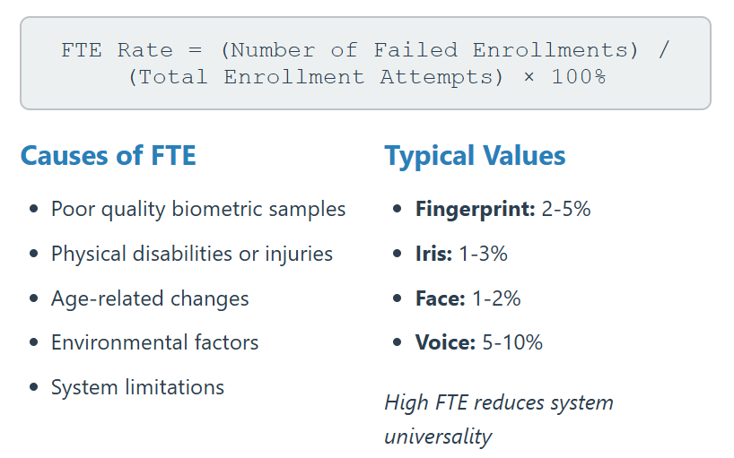
Failure to Enroll (FTE) Rate
Definition
Percentage of users who cannot successfully enroll in the biometric system
Notes:
FTE — Failure to Enroll System universality. The rate at which individuals cannot be enrolled in the system at all — due to factors like worn fingerprints, certain disabilities, or sensor limitations. This measures how well the system accommodates the full population it's meant to serve.
System universality. The rate at which individuals cannot be enrolled in the system at all — due to factors like worn fingerprints, certain disabilities, or sensor limitations. This measures how well the system accommodates the full population it's meant to serve.

Slide 6
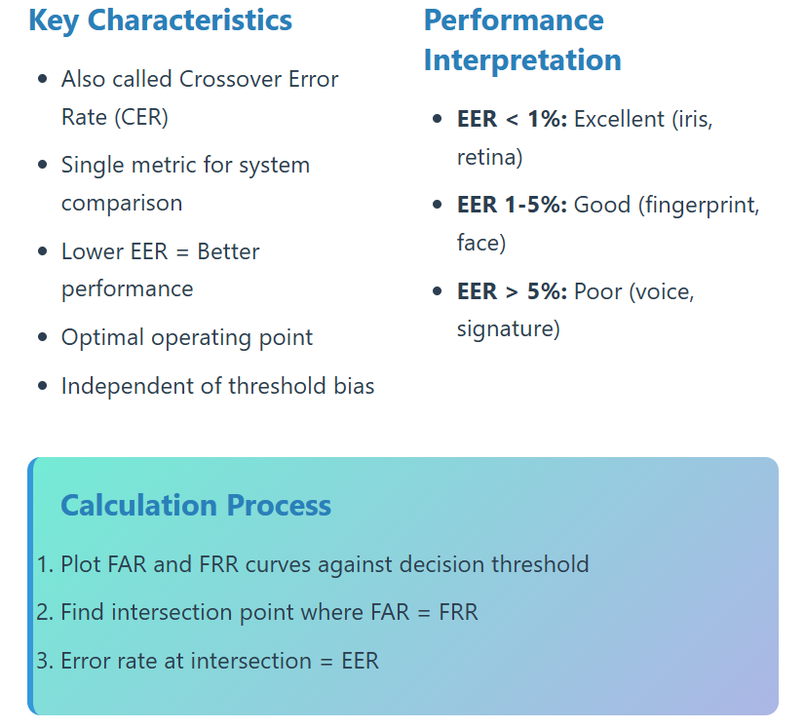
Equal Error Rate (EER)
Definition
The point where False Accept Rate equals False Reject Rate
Notes:
EER — Equal Error Rate Overall performance. The point at which FAR and FRR are equal — the threshold where false accepts and false rejects occur at the same rate. A lower EER indicates a more accurate system overall, and it's commonly used to compare different biometric systems on a single number.
Overall performance. The point at which FAR and FRR are equal — the threshold where false accepts and false rejects occur at the same rate. A lower EER indicates a more accurate system overall, and it's commonly used to compare different biometric systems on a single number.

Slide 7
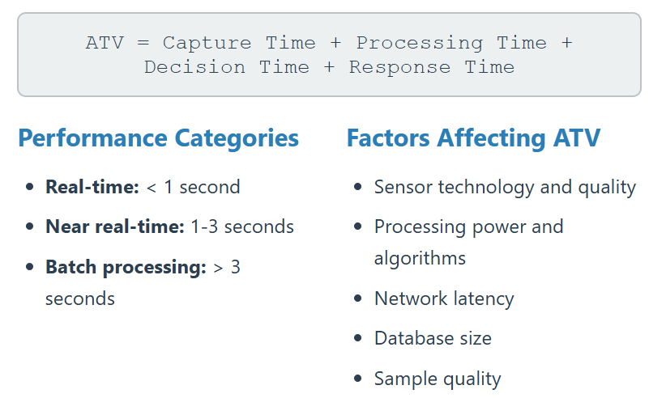
Acquisition Time to Verification (ATV)
Definition
Total time from biometric presentation to verification decision
Notes:
ATV — Acquisition Time to Verification System speed. The time required to capture the biometric sample and complete verification. This affects throughput and user experience, particularly in high-volume settings like airports or turnstiles.
System speed. The time required to capture the biometric sample and complete verification. This affects throughput and user experience, particularly in high-volume settings like airports or turnstiles.

Slide 8
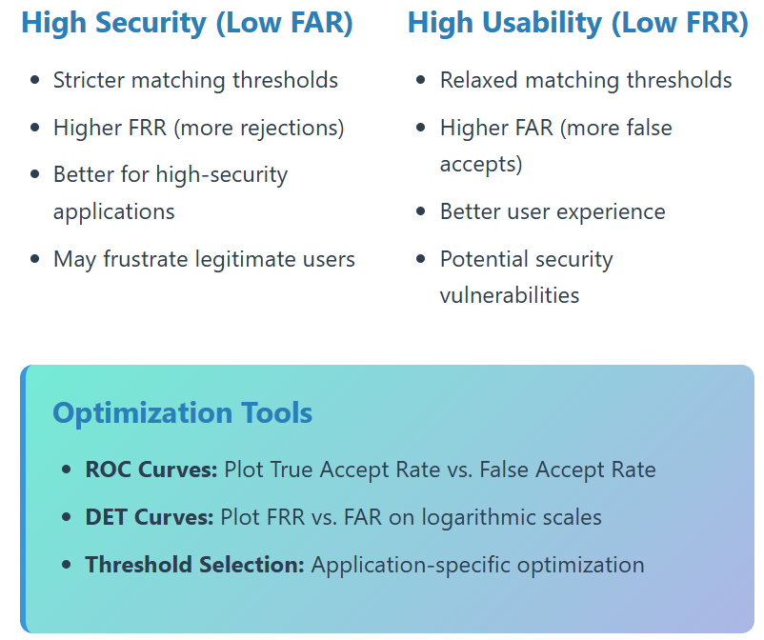
Performance Trade-offs
Fundamental Challenge
Security vs. Usability Trade-off: FAR and FRR are inversely related
Notes:
Slide intro FAR and FRR aren't independent — they're inversely linked through the system's matching threshold. Moving the threshold to improve one necessarily worsens the other.
Fundamental Challenge No single threshold optimizes both FAR and FRR simultaneously — every setting is a tradeoff point.
High Security (Low FAR)
Stricter thresholds: requires a closer match to accept
Higher FRR: more legitimate users rejected, as a direct consequence
Use case: high-stakes contexts (border control, finance) where false accepts are costlier than false rejects
Cost: increased friction for legitimate users
High Usability (Low FRR)
Relaxed thresholds: accepts a looser match
Higher FAR: more impostors accepted, as a direct consequence
Use case: convenience-focused contexts where smooth access matters more than strict exclusion
Cost: increased exposure to unauthorized access
Optimization Tools
ROC curves: plot True Accept Rate vs. False Accept Rate across all thresholds — visualizes the full tradeoff space
DET curves: plot FRR vs. FAR on logarithmic scales — clearer resolution at the low-error range where real systems operate
Threshold selection: set per application, based on its specific risk tolerance and usability needs — not a fixed universal value
Closing line The right threshold depends on what's being protected and who the system must serve — there's no universal optimum.

Slide 9
Applications of Biometric Systems
Access Control
  Building access, computer login, vehicle systems
Government
  National ID, passports, voting, border control
Financial Services
  ATM, mobile banking, fraud prevention
Healthcare
  Patient ID, record access, drug monitoring
Time & Attendance
  Employee tracking, payroll integration
Mobile/Consumer
  Smartphone unlock, payments, apps
Law Enforcement
  Criminal ID, forensics, investigations

Slide 10
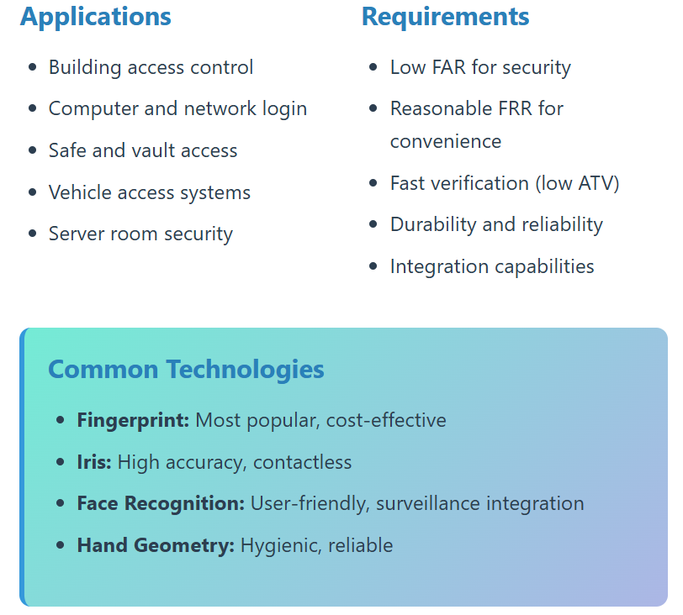
Access Control and Physical Security
Notes:
Applications
Building access control: securing entry to offices, facilities, or restricted zones
Computer and network login: biometric authentication replacing or supplementing passwords
Safe and vault access: high-security storage requiring strong identity assurance
Vehicle access systems: biometric-based entry and ignition control
Server room security: protecting critical infrastructure with restricted physical access
Requirements These map directly to the performance metrics from earlier slides:
Low FAR for security: minimizing unauthorized access is the priority in these contexts
Reasonable FRR for convenience: rejections shouldn't be so frequent that they disrupt normal operations
Fast verification (low ATV): access points need quick throughput, especially at high-traffic entries
Durability and reliability: hardware must withstand continuous, often unsupervised, real-world use
Integration capabilities: must interface with existing security infrastructure — door controllers, logging systems, alarms
Common Technologies
Fingerprint: most popular option, cost-effective to deploy at scale
Iris: high accuracy with contactless operation — reduces hygiene concerns and hardware wear
Face recognition: user-friendly with minimal user cooperation required, and integrates well with existing surveillance camera infrastructure
Hand geometry: hygienic and reliable, though generally less discriminative than fingerprint or iris
The technology choice in each deployment comes down to weighing these requirements against the specific context — a server room prioritizes low FAR above all, while a building lobby may prioritize speed and user convenience.

Slide 11
Security Vulnerabilities
Spoofing Attacks
Definition: Attempts to fool biometric sensors using fake traits
  Fingerprint: Silicone molds, printed patterns
  Face: Photos, videos, 3D masks
  Iris: Printed patterns, contact lenses
  Voice: Recorded audio, synthesis
Template Security
  Template theft from databases
  Template modification or corruption
  Cross-matching between systems
  Biometric reconstruction from templates
Transmission Security
  Man-in-the-middle attacks
  Replay attacks with intercepted data
  Protocol vulnerabilities
Notes:
Biometric systems can be attacked at three distinct points: capture, storage, and transmission. Each requires different countermeasures.
Spoofing Attacks
Definition: presenting a fake biometric trait to the sensor instead of a live one.
Fingerprint: silicone/gelatin molds cast from lifted prints; printed conductive patterns
Face: printed photos, replayed video, 3D-printed or silicone masks
Iris: high-resolution printed iris images, sometimes paired with textured contact lenses
Voice: replayed recordings; AI-synthesized speech cloned from short voice samples
Core defense: liveness detection — verifying the trait comes from a living subject, not a replica.
Template Security
Note: systems store a derived mathematical template, not the raw biometric image.
Template theft: database breach exposes stored templates — unlike passwords, biometrics can't be reset
Template modification/corruption: altering stored data to deny legitimate access or admit an attacker
Cross-matching: shared template formats across systems allow identity correlation without consent — a privacy risk, not just a security one
Reconstruction: recovering an approximation of the original biometric from the template, under certain algorithmic conditions
Core defense: template encryption, cancelable biometrics, secure storage architecture.
Transmission Security
Threats during data transfer between sensor and authentication server.
Man-in-the-middle: interception and possible alteration of data in transit
Replay attacks: capturing valid authentication data and resubmitting it later
Protocol vulnerabilities: weaknesses in the communication protocol itself, independent of the biometric data
Core defense: encrypted channels, mutual authentication, challenge-response protocols.
Security is only as strong as the weakest of these three layers — an attacker needs just one point of failure.

Slide 12
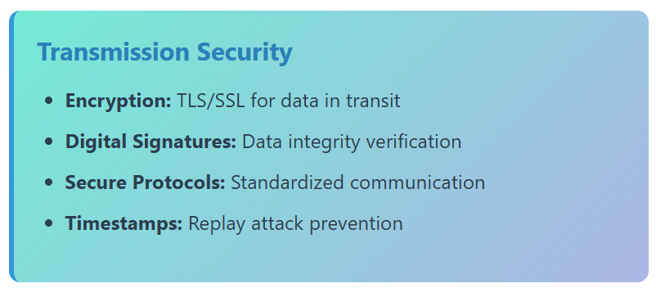
Security Countermeasures
Anti-Spoofing Measures
Liveness Detection: Pulse, blood flow, movement
Multi-modal Systems: Multiple biometric traits
Challenge-Response: Dynamic verification
Advanced Sensors: 3D imaging, infrared
Template Protection
Encryption: Cryptographic protection
Cancelable Biometrics: Irreversible transforms
Biometric Cryptosystems: Key integration
Standards: ISO/IEC 24745
Notes:
Anti-Spoofing Measures
Liveness detection: verifies physiological signs of a living subject — pulse, blood flow, involuntary movement — to distinguish a real trait from a static replica.
Multi-modal systems: require two or more biometric traits together (e.g., fingerprint + face), raising the difficulty of spoofing all channels simultaneously.
Challenge-response: prompts the user for a randomized action (blink, turn head, speak a phrase) during capture, defeating pre-recorded or static spoofs.
Advanced sensors: 3D imaging and infrared capture depth and sub-surface detail that flat images, masks, or screens can't replicate.
Template Protection
Encryption: stored templates are cryptographically protected, so a database breach doesn't expose usable biometric data.
Cancelable biometrics: templates are generated through an irreversible transform of the original trait — if compromised, they can be revoked and regenerated, similar to resetting a password.
Biometric cryptosystems: bind the biometric template to a cryptographic key, so authentication requires both to succeed.
Standards: ISO/IEC 24745 governs biometric information protection, providing a common baseline for secure template handling.
Transmission Security
Encryption (TLS/SSL): secures biometric data while in transit between sensor and server.
Digital signatures: verify that transmitted data hasn't been altered en route.
Secure protocols: standardized, vetted communication protocols reduce exposure to implementation-level vulnerabilities.
Timestamps: invalidate old captured data, directly preventing replay attacks.

Slide 13
Privacy Concerns
Data Collection and Storage
  Excessive data collection beyond requirements
  Indefinite storage of biometric data
  Lack of user consent and awareness
  Secondary use of collected data
Surveillance and Tracking
  Covert identification in public spaces
  Cross-system tracking and profiling
  Government surveillance programs
  Commercial tracking for marketing
Function Creep
Definition: Gradual expansion beyond original purpose
  Attendance → Performance monitoring
  Access control → Behavioral analysis
  Verification → Continuous monitoring
Notes:
These are privacy risks inherent to biometric systems, distinct from technical security flaws — they exist even when systems work exactly as designed.
Data Collection and Storage
Excessive collection: systems capture more data than the stated purpose requires
Indefinite storage: biometric data retained with no defined deletion policy
Lack of consent/awareness: individuals scanned or enrolled without understanding use or scope
Secondary use: data repurposed beyond its original collection purpose, without renewed consent
Surveillance and Tracking
Covert identification: facial recognition identifies individuals in public without their knowledge
Cross-system tracking: linking biometric data across systems enables composite profiling of movement and behavior
Government surveillance: state use for population-level monitoring — a civil liberties concern
Commercial tracking: businesses use biometric ID for behavioral/marketing data, often undisclosed
Function Creep
Definition: gradual expansion of system use beyond its original purpose.
Attendance → Performance monitoring: logging shifts to employee evaluation
Access control → Behavioral analysis: entry management shifts to pattern analysis
Verification → Continuous monitoring: one-time ID check shifts to ongoing tracking
Function creep matters because each expansion looks reasonable individually — the risk is cumulative, ending in systems far beyond original user consent.

